Slide 1
Learning algorithms
optimizer
Partial derivative
iteration
Loss function
batch
derivative
epoch
optimization
Gradient Descent
momentum
SGD Classifier
stochastic Gradient Descent
Learning rate

Slide 2
Epoch
One Epoch is when an ENTIRE dataset is passed forward and backward through the neural network only once
Batch size
Total number of training examples present in a single batch
Iteration
The Number of passes to complete one epoch

Slide 3
Batch size
Data Set
1 Epoch
Iteration
The Number of passes to complete one epoch

Slide 4
Total data : 2000
Epochs = 20
Batch size = 500

Slide 5
Total data : 2000
Epochs = 20
Batch size = 500
How is an epoch organized?

Slide 6
500
1
2
3
4
4 iteration
1 Epoch

Slide 7
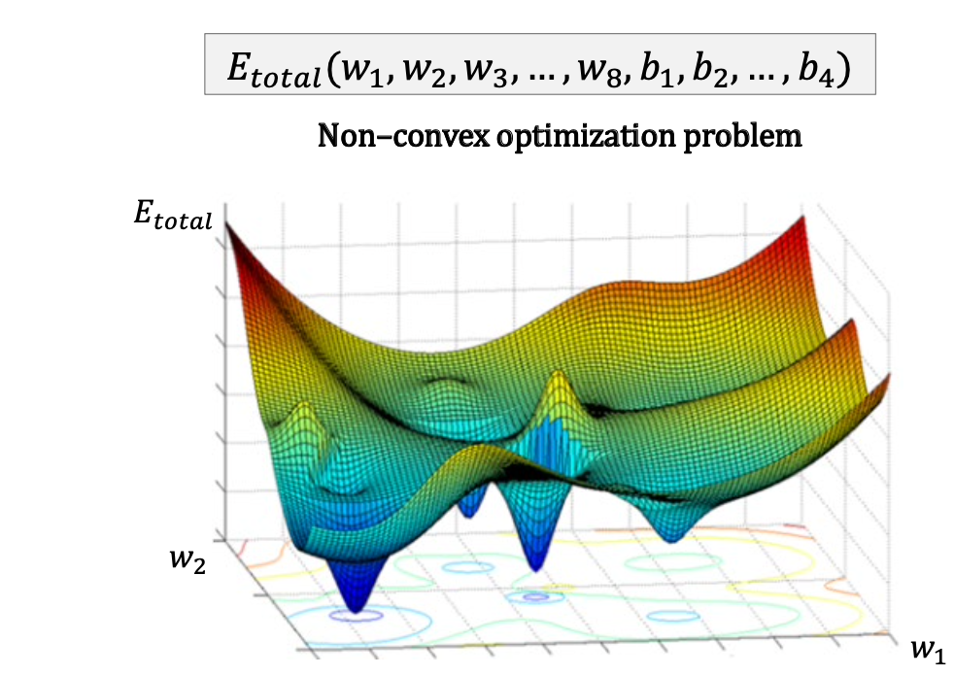

Slide 8
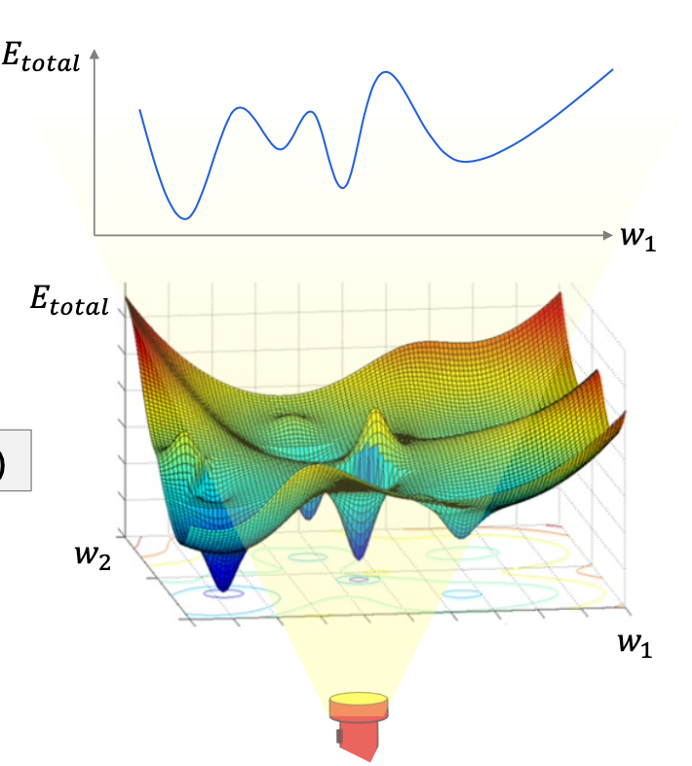

Slide 9
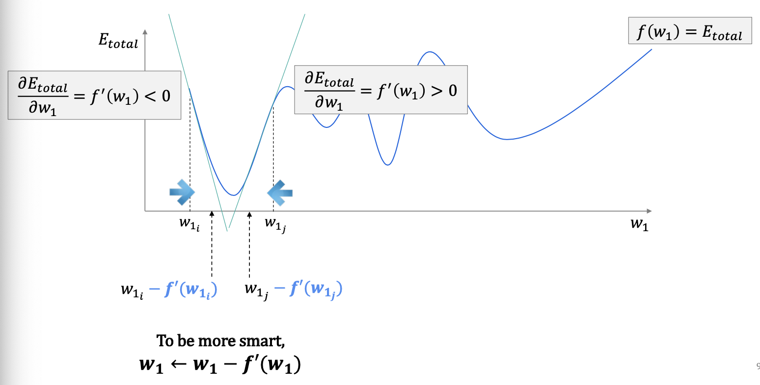

Slide 10
Random!
1
1 Epoch
SGD Classifier
stochastic Gradient Descent

Slide 11
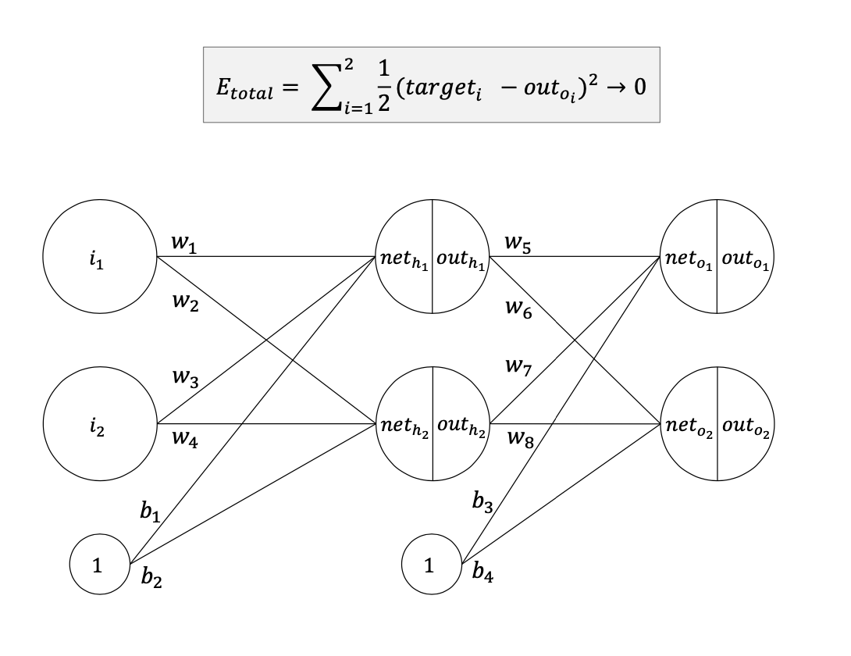

속도 ㅈㄴ 빠름
정확도 ㅈㄴ 낮음
SGD Classifier
stochastic Gradient Descent

